Slide 1
Unit-2 Read Aloud Listen & Repeat

Slide 2
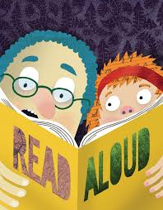

Slide 3
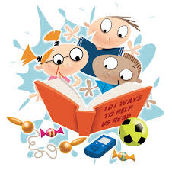
Read Aloud is a technique used to improve speech and communication skills by reading a text aloud and receiving feedback on pronunciation, intonation, fluency, and articulation.

Slide 4
Benefits of reading aloud to children
Strengthens speaking, listening, writing and reading and comprehension skills
Increases vocabulary
It helps students appreciate the beauty and rhythm of language
Enhances imagination and observation skills

Slide 5
Let’s practice read aloud
Remember to practice reading aloud with attention to:-
Articulation
Pronunciation
Fluency

Slide 6
Read aloud for speech correction
"The sun was shining brightly in the clear blue sky. The birds were singing their sweet melodies. It was a beautiful day.“
Note: Put stress on the bold words.

Slide 7
Read aloud for Speech correction
"I'm going to the store to buy some milk.”
"The weather is going to be sunny tomorrow.”
"I love reading books because they're so interesting.”
"The new restaurant in town serves delicious food at reasonable prices."

Slide 8
Read aloud for Speech correction
Paragraph 1:
"The sun rises over the mountains, casting a warm glow over the landscape. The birds sing their sweet melodies, filling the air with joyful sounds.”
Note: Put appropriate stress and emphasize on important words.

Slide 9
Read aloud for Speech correction
Paragraph 2:
"The city comes alive at night, with lights and sounds that never seem to end. The streets are filled with people from all walks of life, each with their own story to tell.”
Note: Put appropriate stress and emphasize on important words.

Slide 10
Read aloud for Speech correction
Paragraph 3:
"The ocean waves crash against the shore, a soothing sound that calms the mind and soul. The salty air fills your lungs, invigorating your senses and refreshing your spirit.”
Note: Put appropriate stress and emphasize on important words.

Slide 11
Read aloud for Speech correction
Paragraph 4:
"The forest is a place of wonder, where trees stretch towards the sky and creatures roam free. The rustling of leaves and chirping of birds create a symphony of sounds that inspire and delight.”
Note: Put appropriate stress and emphasize on important words.

Slide 12
Read aloud for Speech correction
Paragraph 5:
"The stars shine brightly in the night sky, a celestial showcase of twinkling lights. The world is full of magic and mystery, waiting to be explored and discovered.”
Note: Put appropriate stress and emphasize on important words.

Slide 13
Listen and repeat
Open the link and practice listen and repeat exercises
https://www.youtube.com/watch?v=62ISCjDow0g

Slide 14
Let’s practice listen and repeat
Open the link and practice listen and repeat exercises
https://www.youtube.com/watch?v=lRxp0T9RI5o

Slide 15
Thank You

